Slide 1

The Fundamental Theorem of Calculus
4.4
Copyright © Cengage Learning. All rights reserved.

Slide 2
Objectives
Evaluate a definite integral using the Fundamental Theorem of Calculus.
Understand and use the Mean Value Theorem for Integrals.
Find the average value of a function over a closed interval.
Understand and use the Second Fundamental Theorem of Calculus.
Understand and use the Net Change Theorem.

Slide 3
The Fundamental Theorem of Calculus

Slide 4
The Fundamental Theorem of Calculus
The two major branches of calculus: differential calculus and integral calculus. At this point, these two problems might seem unrelated—but there is a very close connection.
The connection was discovered independently by Isaac Newton and Gottfried Leibniz and is stated in a theorem that is appropriately called the Fundamental Theorem of Calculus.

Slide 5
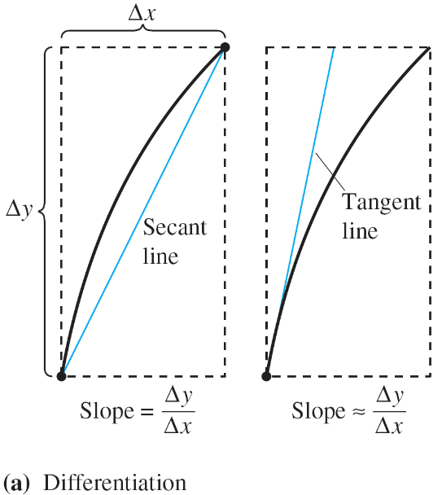
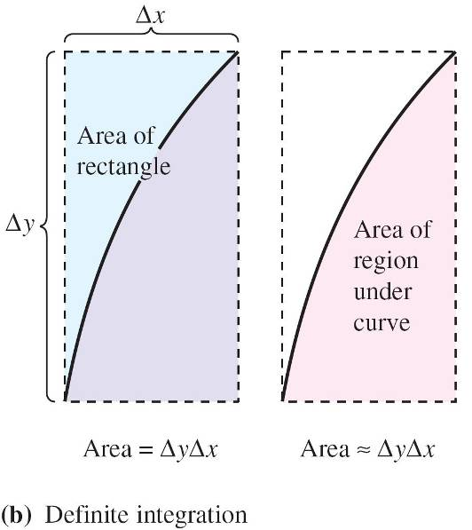
The Fundamental Theorem of Calculus
Informally, the theorem states that differentiation and (definite) integration are inverse operations, in the same sense that division and multiplication are inverse operations. To see how Newton and Leibniz might have anticipated this relationship, consider the approximations shown in Figure 4.26.
Figure 4.26

Slide 6
The Fundamental Theorem of Calculus
The slope of the tangent line was defined using the quotient Δy/Δx.
Similarly, the area of a region under a curve was defined using the product ΔyΔx.
So, at least in the primitive approximation stage, the operations of differentiation and definite integration appear to have an inverse relationship in the same sense that division and multiplication are inverse operations.
The Fundamental Theorem of Calculus states that the limit processes preserve this inverse relationship.

Slide 7
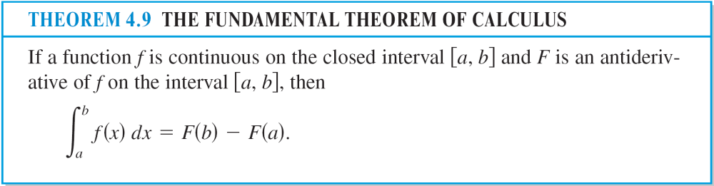
The Fundamental Theorem of Calculus

Slide 8
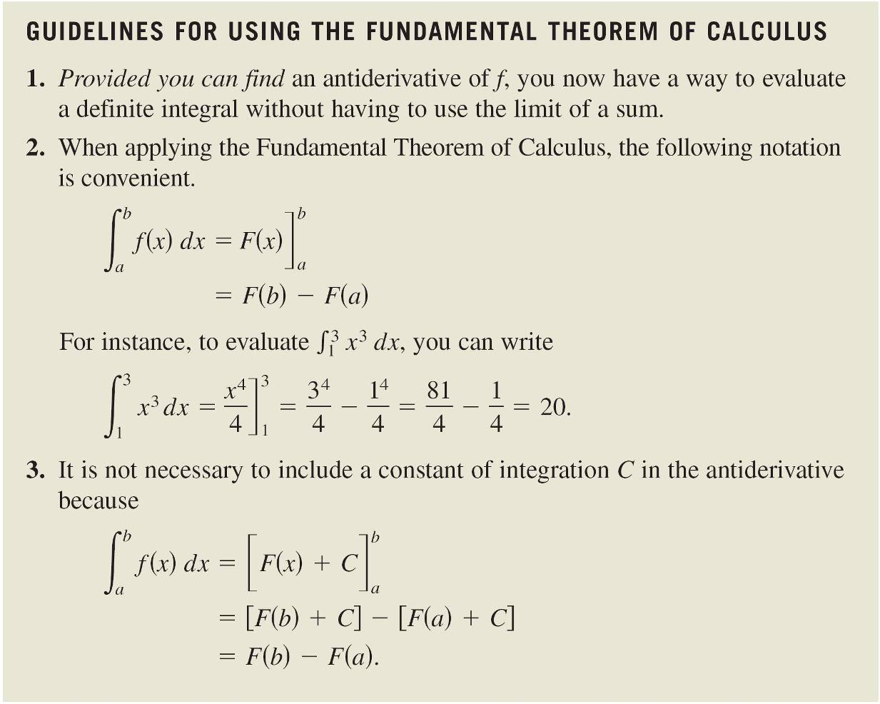
The Fundamental Theorem of Calculus
The following guidelines can help you understand the use of the Fundamental Theorem of Calculus.

Slide 9
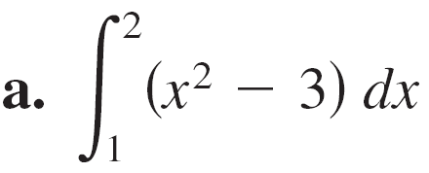
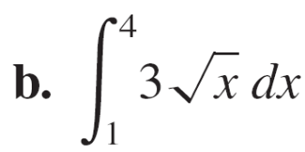
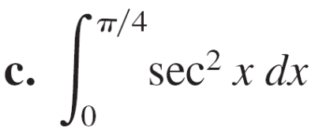
Example 1 – Evaluating a Definite Integral
Evaluate each definite integral.

Slide 10
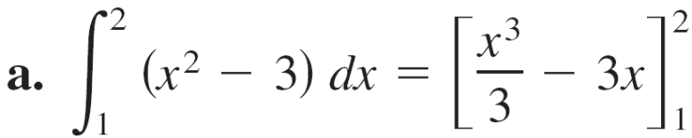
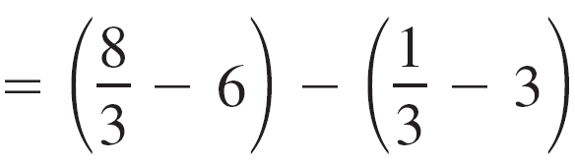
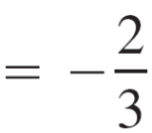
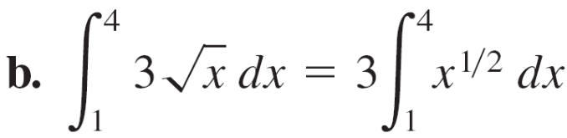
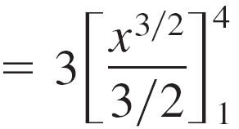


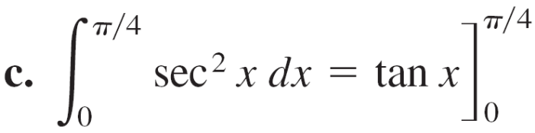


Example 1 – Solution

Slide 11
The Mean Value Theorem for Integrals

Slide 12
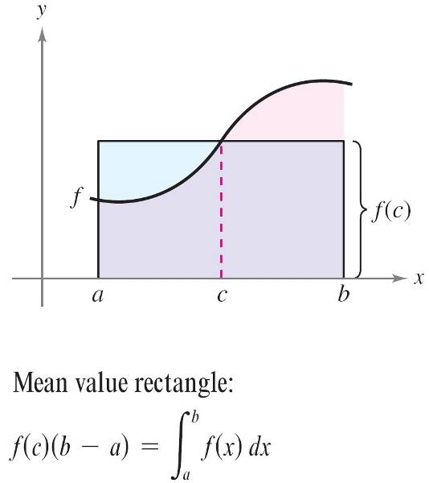
The Mean Value Theorem for Integrals
The area of a region under a curve is greater than the area of an inscribed rectangle and less than the area of a circumscribed rectangle. The Mean Value Theorem for Integrals states that somewhere “between” the inscribed and circumscribed rectangles there is a rectangle whose area is precisely equal to the area of the region under the curve, as shown in Figure 4.29.
Figure 4.29

Slide 13
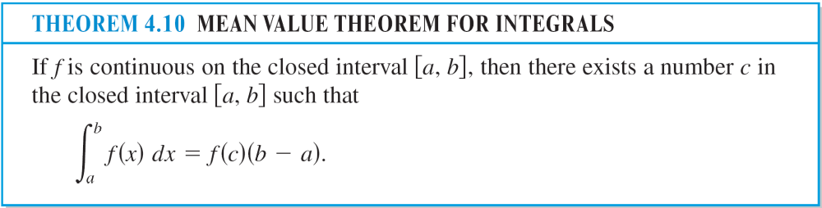
The Mean Value Theorem for Integrals

Slide 14
Average Value of a Function

Slide 15
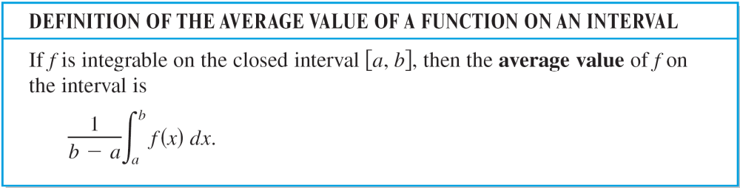
Average Value of a Function
The value of f(c) given in the Mean Value Theorem for Integrals is called the average value of f on the interval [a, b].

Slide 16
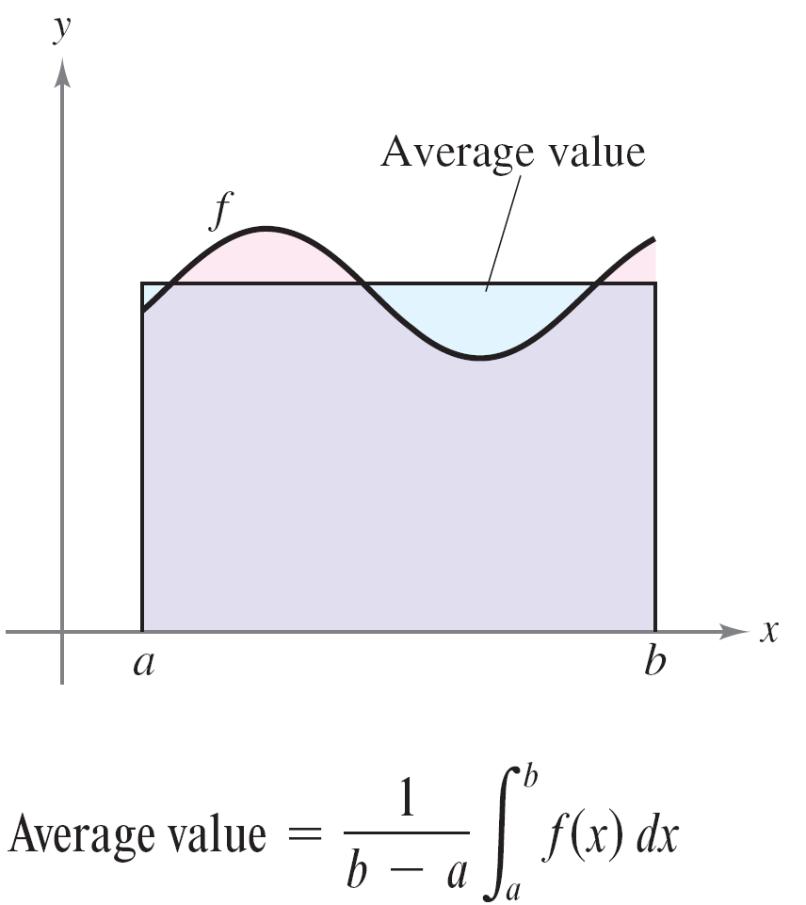
Average Value of a Function
In Figure 4.31 the area of the region under the graph of f is equal to the area of the rectangle whose height is the average value.
Figure 4.31

Slide 17
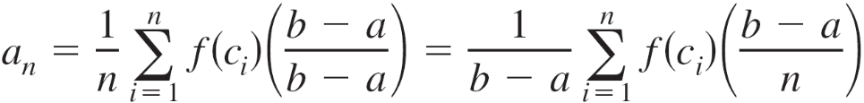
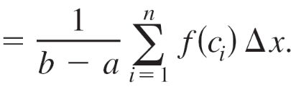
Average Value of a Function
To see why the average value of f is defined in this way, suppose that you partition [a, b] into n subintervals of equal width Δx = (b – a)/n. If c_{i} is any point in the ith subinterval, the arithmetic average (or mean) of the function values at the c_{i}’s is given by
By multiplying and dividing by (b – a) you can write the average as

Slide 18

Average Value of a Function
Finally, taking the limit as produces the average value of f on the interval [a, b] as given in the definition above.

Slide 19
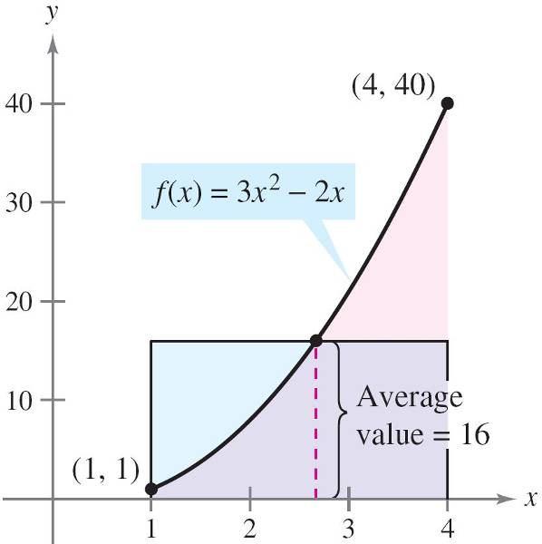
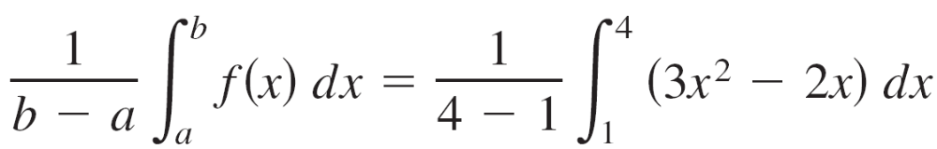
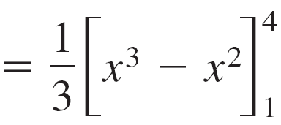
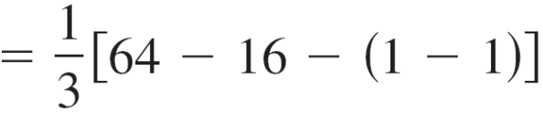
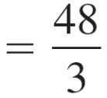

Example 4 – Finding the Average Value of a Function
Find the average value of f(x) = 3x² – 2x on the interval [1, 4].
Solution:
The average value is given by
(See Figure 4.32.)
Figure 4.32

Slide 20
The Second Fundamental Theorem of Calculus

Slide 21
The Second Fundamental Theorem of Calculus
The definite integral of f on the interval [a, b] is defined using the constant b as the upper limit of integration and x as the variable of integration.
A slightly different situation may arise in which the variable x is used in the upper limit of integration.
To avoid the confusion of using x in two different ways, t is temporarily used as the variable of integration.

Slide 22
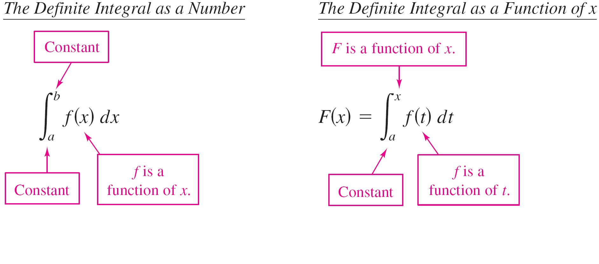
The Second Fundamental Theorem of Calculus

Slide 23
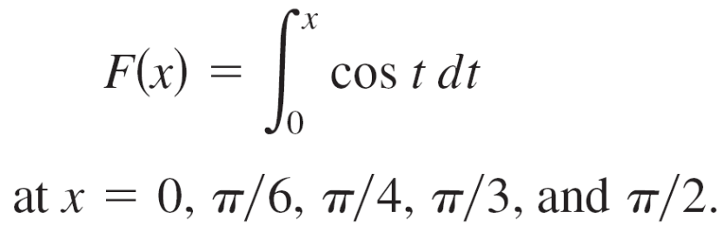
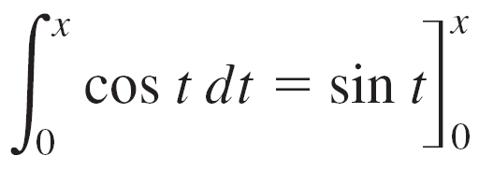


Example 6 – The Definite Integral as a Function
Evaluate the function
Solution:
You could evaluate five different definite integrals, one for each of the given upper limits.
However, it is much simpler to fix x (as a constant) temporarily to obtain

Slide 24
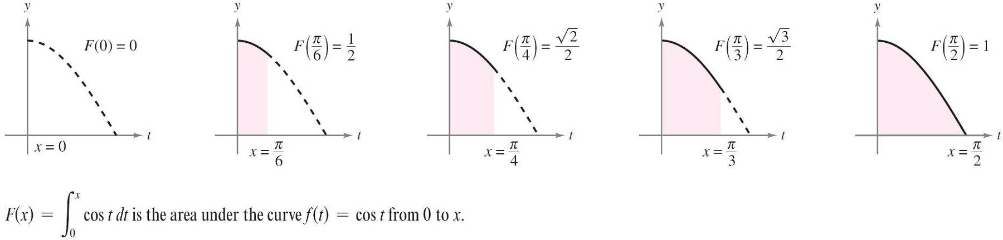
Example 6 – Solution
cont’d
Now, using F(x) = sin x, you can obtain the results shown in
Figure 4.34.
Figure 4.34

Slide 25
The Second Fundamental Theorem of Calculus
The function F(x) as accumulating the area under the curve f(t) = cos t from t = 0 to t = x.
For x = 0, the area is 0 and F(0) = 0. For x = π/2, F(π/2) = 1 gives the accumulated area under the cosine curve on the entire interval [0, π/2].
This interpretation of an integral as an accumulation function is used often in applications of integration.

Slide 26
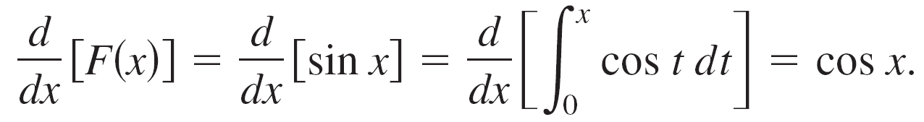
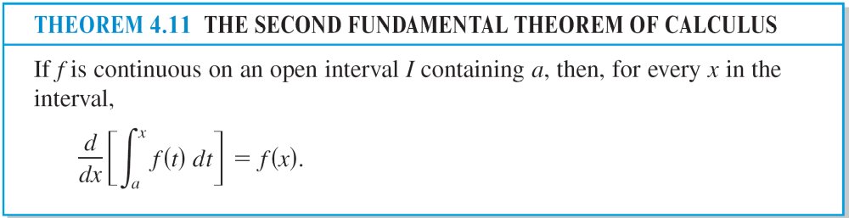
The Second Fundamental Theorem of Calculus
The derivative of F is the original integrand.
That is,
This result is generalized in the following theorem, called the Second Fundamental Theorem of Calculus.

Slide 27
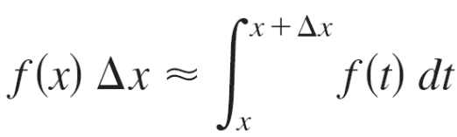
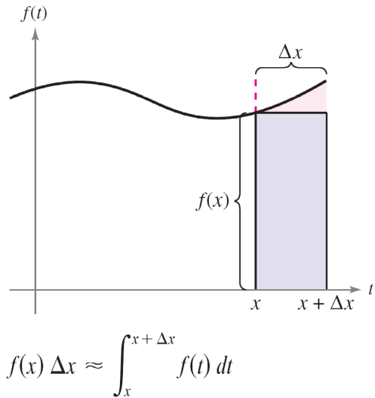
The Second Fundamental Theorem of Calculus
Using the area model for definite integrals, you can view the approximation
as saying that the area of the rectangle of height f(x) and width Δx is approximately equal to the area of the region lying between the graph of f and the x-axis on the interval [x, x + Δx], as shown in Figure 4.35.
Figure 4.35

Slide 28
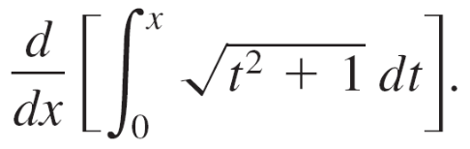

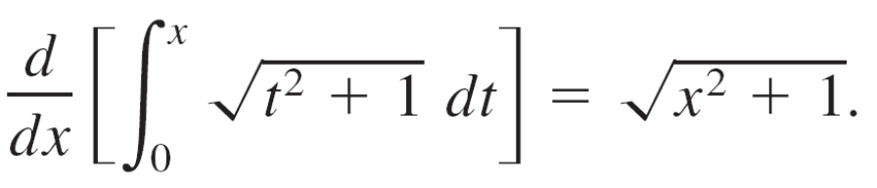
Example 7 – Using the Second Fundamental Theorem of Calculus
Evaluate
Solution:
Note that is continuous on the entire real line.
So, using the Second Fundamental Theorem of Calculus, you can write

Slide 29
Net Change Theorem

Slide 30
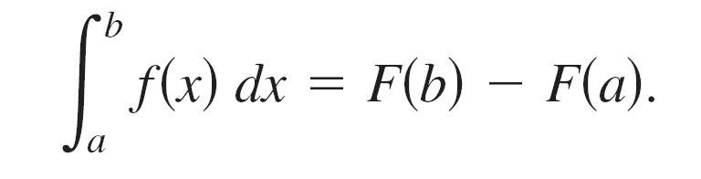
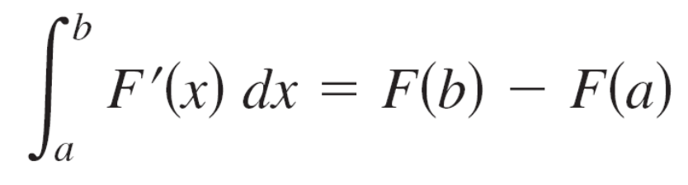
Net Change Theorem
The Fundamental Theorem of Calculus states that if f is continuous on the closed interval [a, b] and F is an antiderivative of f on [a, b], then
But because F'(x) = f(x), this statement can be rewritten as
where the quantity F(b) – F(a) represents the net change of F on the interval [a, b].

Slide 31
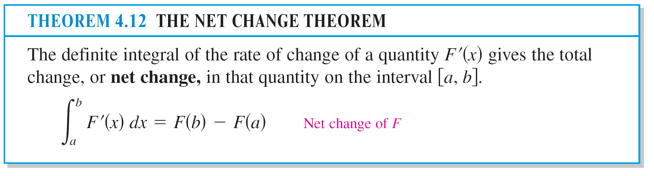
Net Change Theorem

Slide 32
Example 9 – Using the Net Change Theorem
A chemical flows into a storage tank at a rate of 180 + 3t liters per minute, where 0 ≤ t ≤ 60. Find the amount of the chemical that flows into the tank during the first 20 minutes.
Solution:
Let c(t) be the amount of the chemical in the tank at time t.
Then c'(t) represents the rate at which the chemical flows into the tank at time t.

Slide 33
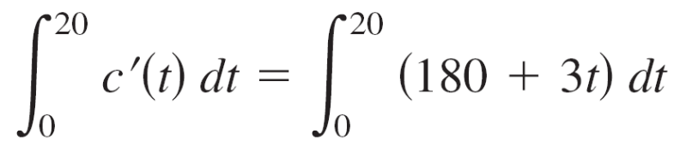
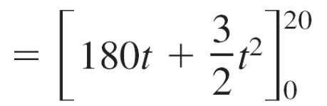
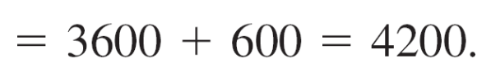
Example 9 – Solution
cont’d
During the first 20 minutes, the amount that flows into the tank is
So, the amount that flows into the tank during the first 20 minutes is 4200 liters.

Slide 34
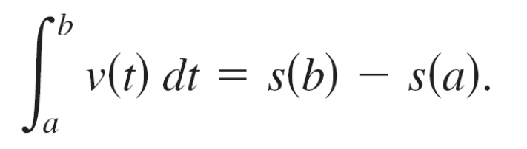
Net Change Theorem
The velocity of a particle moving along a straight line where s(t) is the position at time t. Then its velocity is v(t) = s'(t) and
This definite integral represents the net change in position, or displacement, of the particle.

Slide 35
Net Change Theorem
When calculating the total distance traveled by the particle, you must consider the intervals where v(t) ≤ 0 and the intervals where v(t) ≥ 0.
When v(t) ≤ 0 the particle moves to the left, and when v(t) ≥ 0, the particle moves to the right.
To calculate the total distance traveled, integrate the absolute value of velocity |v(t)|.

Slide 36
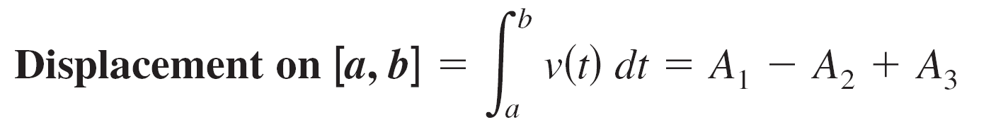
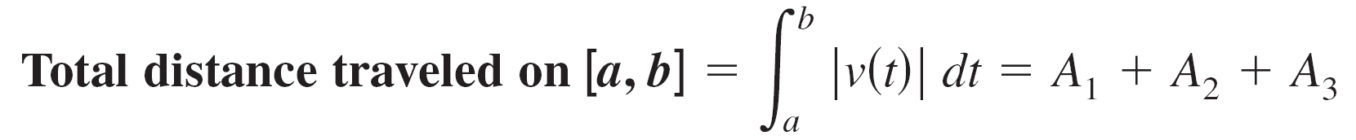
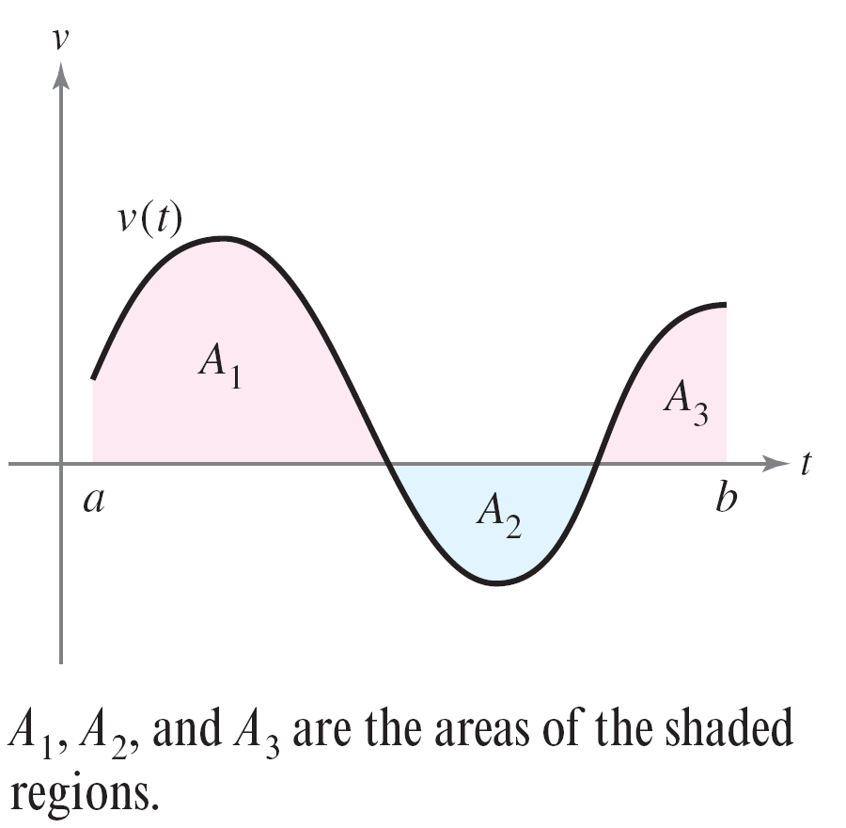
Net Change Theorem
So, the displacement of a particle and the total distance traveled by a particle over [a, b] can be written as
(see Figure 4.36).
Figure 4.36

Slide 37
Example 10 – Solving a Particle Motion Problem
A particle is moving along a line so that its velocity is v(t) = t³ – 10t² + 29t – 20 feet per second at time t.
What is the displacement of the particle on the time
interval 1 ≤ t ≤ 5?
b. What is the total distance traveled by the particle on the
time interval 1 ≤ t ≤ 5?

Slide 38
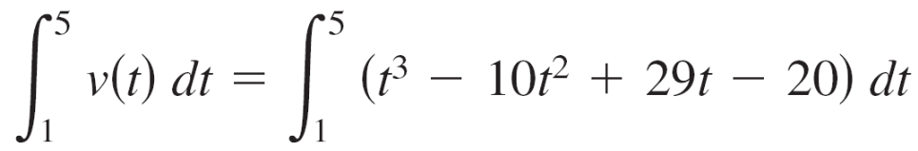
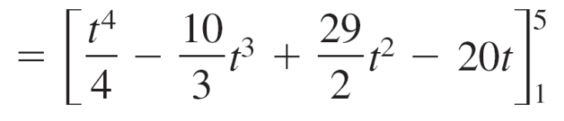
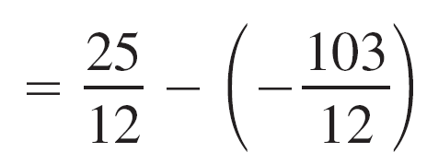
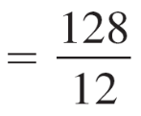
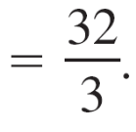

Example 10(a) – Solution
By definition, you know that the displacement is
So, the particle moves feet to the right.

Slide 39
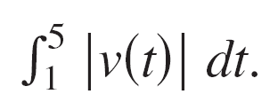

Example 10(b) – Solution
cont’d
To find the total distance traveled, calculate
Using Figure 4.37 and the fact that v(t) can be factored as (t – 1)(t – 4)(t – 5), you can determine that v(t) ≥ 0 on [1, 4] and on v(t) ≤ 0 on [4, 5].
Figure 4.37

Slide 40





Example 10(b) – Solution
cont’d
So, the total distance traveled is

